Slide 1
Codex Customer Analysis
Presented by: Ajay Shetye
Last Updated: November 11th, 2023

Slide 2
Codex Customer Analysis
Table of Contents
Purpose Statement
Survey Response Analysis
Recommendations

Slide 3
Objective
Analyze the survey data to extract the meaningful insights that will guide strategic decision-making and operational actions, enabling the team to leverage the findings effectively for improved performance and targeted initiative.

Slide 4
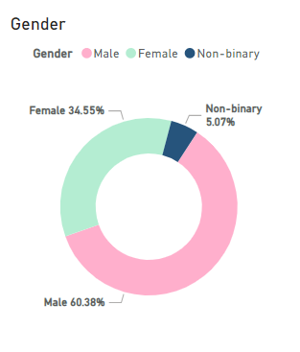
Who prefers energy drink more? (male/female/non-binary?)
Males highly prefers energy drinks
Among the respondents, 60 % males show high preference for the energy drinks

Slide 5
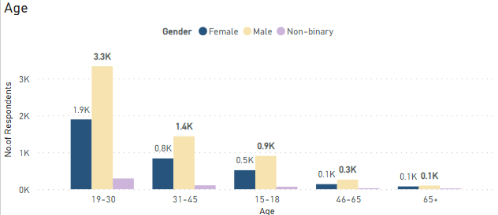
Which age group prefers energy drinks more?
19-30 Age Group : Top Energy Drink Consumer
19-30 Age group highly prefer energy drinks followed by 31-45 and then 15-18 Age group.

Slide 6
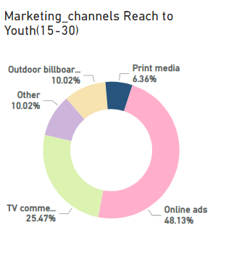
Which type of marketing reaches the most Youth (15-30)?
Online Ads is the most effective marketing channels
Online ads effective reach 49% youth(15-30) respondent followed by TV Commercials with 26%

Slide 7
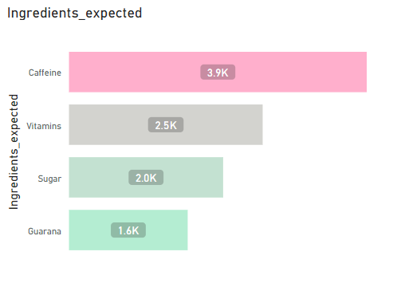
What are the preferred ingredients of energy drinks among respondents?
Caffeine and Vitamins are most preferred ingredients in energy drinks among the respondents.

Slide 8
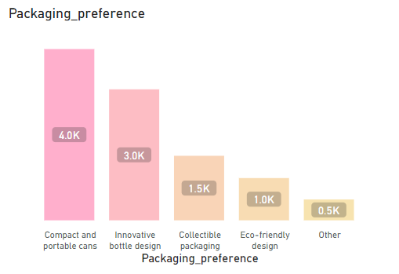
What packaging preferences do respondents have for energy drinks?
Compact and portable cans are the top preferred packaging followed by innovative bottle design.

Slide 9
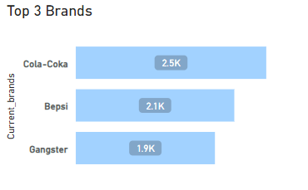
Who are the current market leaders?
Cola-Coka, Bepsi and Gangster rank as the top three energy drinks brands.
Cola-Coka is at the top of all brands with 2.5 K respondents.

Slide 10
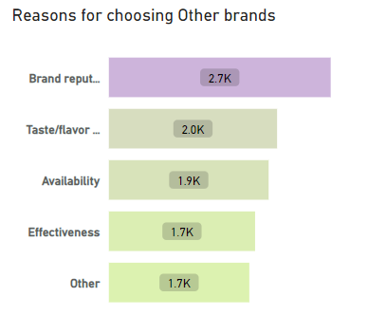
What are the primary reasons consumers prefer those brands over ours?
Consumer preferences for energy drinks are influenced by brand reputation, wide range of taste/flavor and product availability.

Slide 11
Which marketing channel can be used to reach more customers?
Consumer preferences for energy drinks are influenced by brand reputation, wide range of taste/flavor and product availability.

Slide 12
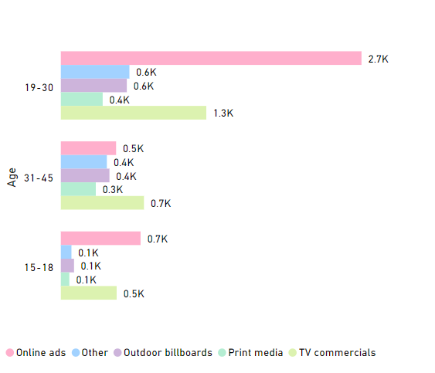
How effective are different marketing strategies and channels in reaching our customers?
Online Ads did well with 19-30 Age group.
TV Commercial prove to be more impactful for the 31-45 Age group

Slide 13
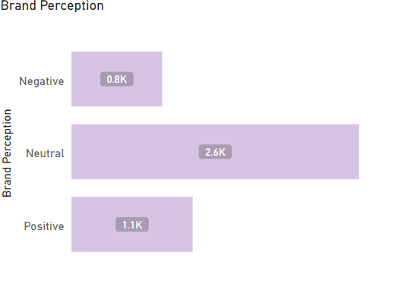
What do people think about our brand? (overall rating)
Among the respondent, most respondent gave neutral brand rating.
This indicate the need of improvement in various areas to shift the neutral rating towards positive sentiment.

Slide 14
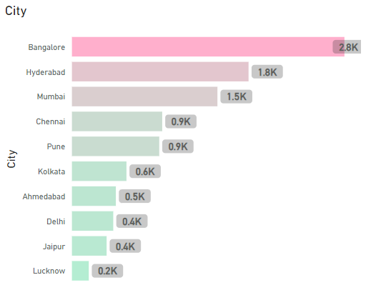
Which cities do we need to focus more on?
Bangalore, Hyderabad, Mumbai and Chennai are the tier 1 cities that needs to focus
Pune and Kolkata are the tier-2 cities shows high concentrate of target audience.

Slide 15
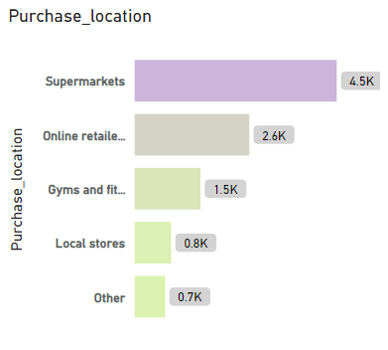
Where do respondents prefer to purchase energy drinks?
Supermarkets are more preferred locations for purchasing energy drinks followed by Online retailers and Gyms.

Slide 16
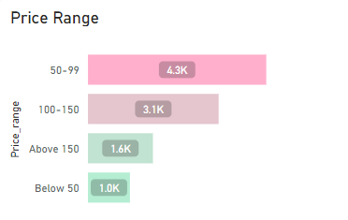
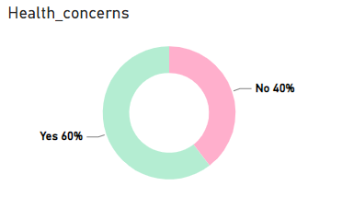
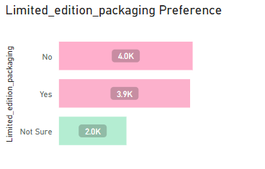
What are the typical consumption situations for energy drinks among respondents?
Most consumer prefer to purchase energy drinks within the price range of 50-99.
60 % respondents prioritize their health.
40 % respondents shows interest in limited edition packaging.

Slide 17
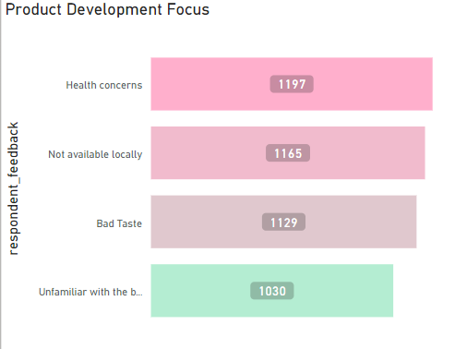
Which area of business should we focus more on our product development? (Branding/taste/availability)
Key areas of focus for product development should be test improvement, ensuring widespread availability and incorporating health-conscious feature to cater customer’s preferences and enhance overall experience.

Slide 18
Recommendations
1
2
3
Target Customer:
Individuals who engaged in Sports and Exercise Activities as well as those who work or study late hours.
Focus Area:
Concentrate on major cities like Bangalore, Mumbai, Chennai, Delhi, Pune, Kolkata
Marketing Strategy:
Use social Media platforms for influencer marketing, Online Ads and TV commercial to engage target audience.

Slide 19
Recommendations
4
5
6
Target Audience:
The main target audience should consist of Males aged between 15 to 45.
Ideal Price:
Ensure the energy drink is affordable within the price range of 50-99 INR
Flavors and Options:
Offer different flavors to cater to varying preference and provide organic or healthy options to attract health-conscious people.

Slide 20
Recommendations
7
8
Collaboration:
Collaborate with famous sport person or athlete who have strong social media presence to connect with targeted audience.
Product Packaging:
Prefer eco-friendly packaging to attract environmentally conscious consumer.

Slide 21
Thank you!

